Slide 1
WOLT
Data Analyst Assignment

Slide 2
Table of Contents
01
02
03
04
Introduction
The goal of the task and its requirements
Main Steps of Analysis
Explain the main process and display observation
Analysis
Explain chosen user segmentation and Descriptive Analysis
Recommendations
Recommend marketing strategies for the best user segment

Slide 3
The task
Your logo
The task is to create a user segmentation that helps the company understand what type of customers they have, explain the main steps of analysis, and communicates the findings.

Slide 4
Main Step of Process
Importt libraries and dataset
Understanding the big picture
01
02
Pandas and Numpy for Data Manipulation.
Matplotlib Pyplot, seaborn, Plotly Express for Data Viz
Exploring variables
Check missing values, abnormality.
Statistic summary
Identify the goal
Data Preparation
Data Visualisation
03
04
Clean data for further analysis
Calculate Recency, Frequency, and Monetary Value
Compute Quantiles of RFM values
Pie Chart
Bar chart
Histogram

Slide 5
Observation 1 – Dataset
Step 2 – Understanding the big picture
The dataset contain 21983 rows with 30 columns related to the purchasing behaviors. Each row correspond to a customer identified by a unique User ID. More specifically, the properties of this dataset present number of purchases, meals/times they purchased, device used to purchase, and store type.
There is one user who made some purchases but “Last purchase date” missing.
The column PURCHASE_COUNT_BY_STORE_TYPE, which lists out the store type user purchase from, has String datatype. It needs to be processed for further calculation.
From the Statistic Summary, there are no abnormal values, which mean, all properties have min from 0. There might be outliers, but they are natural, not mistakes. In this case, if we do not build any machine learning model, there is no need to remove them.

Slide 6
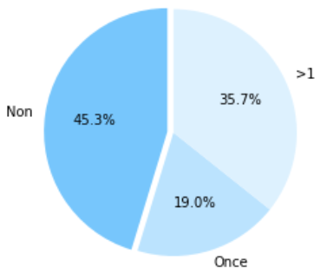
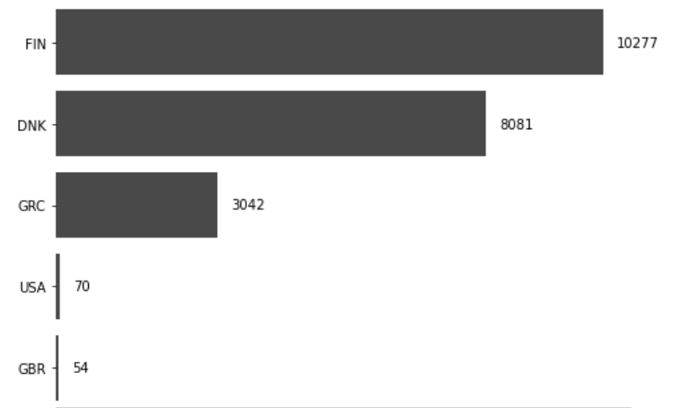
Observation 2 – Some key findings
Step 2 – Understanding the big picture
There are 21983 users who registered, of which 45% has not made any purchase, 19% made one purchase, and 35.7% made more than one.
Most users come from Finland followed by Denmark and Greece.

Slide 7
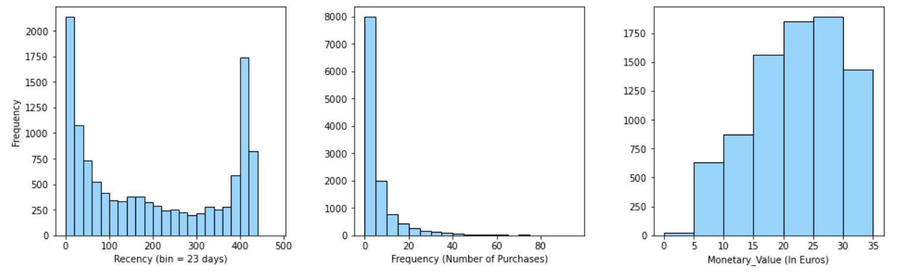
Observation 3 – RFM Distribution
Step 2 – Understanding the big picture
Over 2000 out of 12027 users (16.6%) has made purchase with 23 days.
Over 66% of the purchasers has bought at most 5 times within given period.
The buyers spend average 15-35 euros on each purchase.

Slide 8
The goal - Expectation
Step 2 – Understanding the big picture
USER SEGMENTATION
Geographical Segmentation
Purchasing behaviour
REGISTRATION_COUNTRY
TOTAL_PURCHASE_VALUE
PURCHASE_COUNT
Others: Device Type, Common hour/weekday to purchase, order meals, store type, etc..
RFM – Recency, Frequency, Monetary
LAST_PURCHASE_DATE
TOTAL_PURCHASE_VALUE
PURCHASE_COUNT
Others: Device Type, Common hour/weekday to purchase, order meals, store type, etc..

Slide 9
RFM Score Calculation
Step 3 – Data Preparation
Recency
Frequency
Monetary Value
= Present Date – Last purchase date
= The number of purchases
= Average purchase value in euros
Quantile | 0 | 0.2 | 0.4 | 0.6 | 0.8
Recency (days) | 0 | 23 | 96 | 243 | 401
Frequency (units) | 0 | 1 | 2 | 4 | 8
Monetary Value (euros) | 0 | 18 | 24 | 31 | 41
Recency Score | 1 | 2 | 3 | 4 | 5
Frequency & Monetary Value Score | 5 | 4 | 3 | 2 | 1

Slide 10
RFM Segmentation (TOP 5)
Step 3 – Data Preparation
 | Description | R-Score | F-Scrore | M-Score
Best Users | The users who bought most recently, most often, and are heavy spenders. | 1 | 1 | 1
Potential Loyalist | The recent customers but spent a good amount and bought more than once. | 1 | 2-3 | 2-3
New users | The users who purchased once or twice but quite recently | 1 | 4-5 | 1-5
At-risk user | The users who purchased often and spent big amounts but haven’t purchased recently. | 2 | 1-2 | 1
Can’t lose them | The user who made biggest purchases, and often, but haven’t returned for a long time. | 3 | 1-2 | 1

Slide 11
RFM Segmentation Approach
PROS
CONS
The key to understand tricky but powerful questions: Who are the best users? Who are about to churn? Who had potential to bring better lifetime value? Or Who must be retained?
Target marketing efforts toward prospects – best users.
Optimize marketing costs by not wasting budget on the wrong segments.
The dataset is relevant to conduct RFM user segmentation.
RFM analysis does not help to explain the needs, motivations, and events behind the purchases, and thus cannot be used to predict customer activity in the future.
Customer demographics such as age, sex and ethnicity are not covered in RFM analysis either.

Slide 12
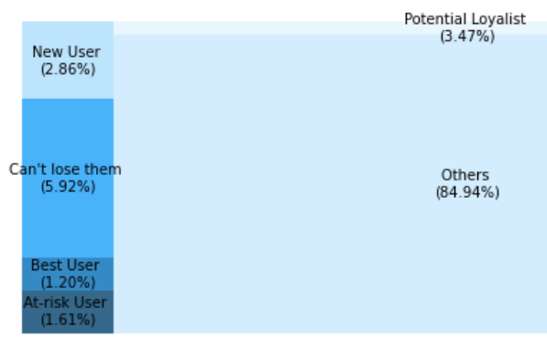
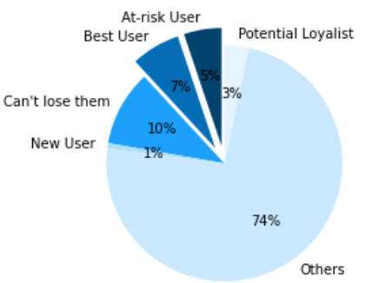
Analysis –All 5 segments
% User Segments
% Total purchase value by Segment
10%
45K
In overall, the five segments take up around 15% of the number of purchasers and account for 26% of the total revenue.
The best users makes up only 1.2% of the total number of purchaser but bring 8% of the total revenue to the company.

Slide 13
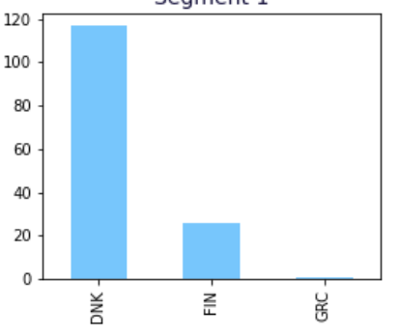
Bar chart - User count by country
Analysis – Segment 1
Segment 1 – our best user segment includes the user who bought more than 8 time (most frequently) within 23 days (most recently) and spent more than average 41 euros per order.
Most best users come from Denmark followed by Finland and Greece.

Slide 14
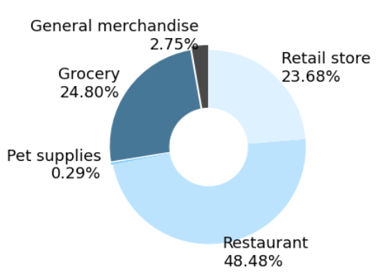
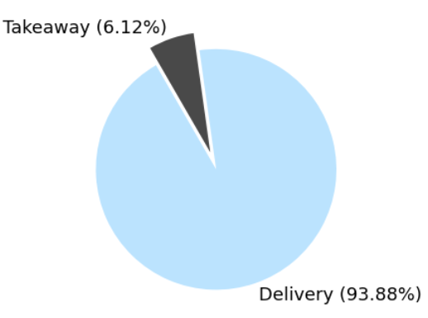
Analysis – Segment 1
Ways of Purchase
Store Type
They tend to purchase more for foods, grocery, and from retail stores.
93.88% of the total number of purchases required delivery instead of taking away from the store.

Slide 15
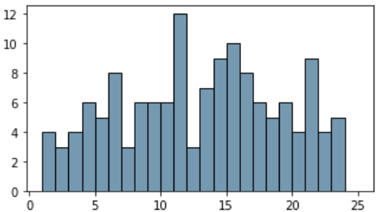
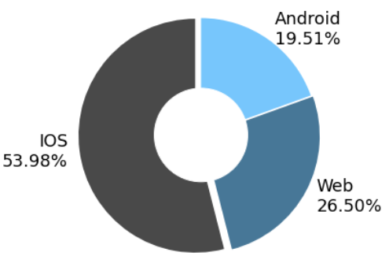
Analysis – Segment 1
Purchase count by device
Most common hour to purchase
According to the pie chart, over half of our best user use IOS devices such as: iPhone, iPad to purchase. The following is Web with 26.5% and Android with 19.51%
The best user segment usually purchase before lunch time (11-12h at noon) , mid noon (15-16h) and dinner (21-22h)

Slide 16
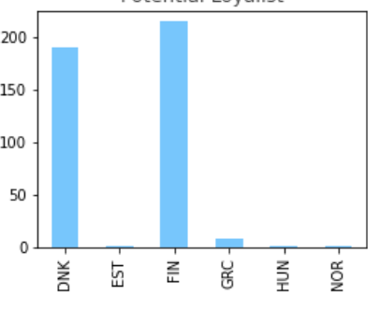
Bar chart - User count by country
Analysis – Segment 3
Segment 3 – the “new user” segment includes the user who bought first or second time within 23 days (most recently). Most best users come from Finland followed by Denmark and a few from Greece.

Slide 17
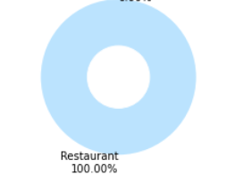
Analysis – Segment 3
Purchase count by store type
Store Type
They tend to purchase more for foods, grocery, and from retail stores.
So far, the new users have only used our app to purchase foods from restaurants.

Slide 18
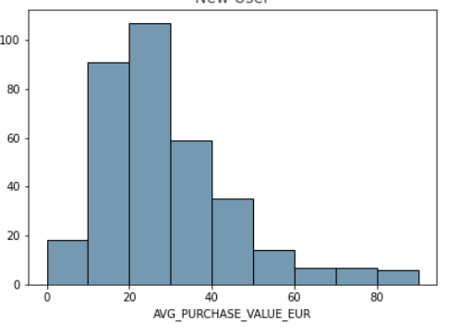
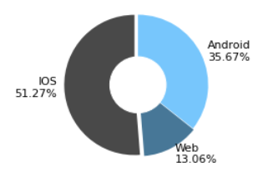
Analysis – Segment 3
Purchase count by device
Like our best users, most new users use IOS to make purchase and unlike best users, they prefer Android to make purchase to Web
These new users are willing to buy foods with the price range from 10-40 euros (mostly from 20-25 euros)

Slide 19
Marketing Recommendation
Segment 1 & 2 – Best Users and Potential Loyalists
Reward them: offer free delivery, special deals, 30-50% discount to reward them for being loyal customers.
Display dynamic and appealing ads with vendors or product ads based on their purchase history.
Recommend them with restaurants or products that are similar to the ones they’ve already order.
Keep bringing new products in the value. The users in this segment might be willing to try new things.
Based on the analysis of this segment, we can make some actions:
- Optimise email marketing, if any, for the devices that most used to get information about our offerings.
- Send an ads/ special offers/ marketing email at the right time, let’s say before their common hour to purchase .

Slide 20
Marketing Recommendation
Segment 3 – New Users
Improve in-app experience to provide onboarding support:
- Ask them what they would like to order and guide them through the whole process in their first- time experience.
- Show them the top-rate restaurants, grocery stores that are having special offers or discounts and the price that they can afford or willing to pay.
Ask them for their feedback: How’s their first experience with our app.
Since the investment on those users can be up to 10 times higher than other segments, carefully measure the users’ lifetime value to determine the marketing budget for these users.
When applying new marketing strategies, make the best use of Web Analytics to understand their interests. Using Statistical Test to evaluate the new marketing method.

Slide 21
Marketing Recommendation
Segment 4 & 5 – At-risk Users and Can’t lose them
These two segments are quite tricky to predict their needs, motivations, and events behind their historical purchases. They spent a big amount but have not visited or purchased recently. Therefore, consider before investing to reactivate their activity. Some recommendations that might be effective:
- Run surveys to find out what’s behind their lack of motivation on using out services.
- Send them personalised reactivation offers to reconnect, act to let them know we do care about them.

Slide 22
Business Strategies Recommendation
01
02
03
Wolt Loyalty Program
Create Loyalty Program to reward loyal users that allows them to enjoy special privileges
Re-evaluate the Wolt+ subscription if it bring more revenue/profits than other membership system
Membership system
There are some E-commerce platforms such as Shopee that proved great success in constantly increasing user visit frequency and purchase by membership ranking system.
Think of Wolt as an E-commerce platform such as Shopee or Grab delivery app, we could rank member on the different levels: Silver, Gold, Diamond, Platinum, etc.. Users love to be ranked and enjoy their own privileges
Tiktoker Influencers
Affiliate marketing in Asian market has received a very positive reaction from audience. People going to buy foods from the restaurants that have great review from Tiktoker or social media influencers.
Collaborating with them, help them make viral videos of our vendors’s services/products and ask them to link to our order system.

Slide 23
Conclusion
In a delivery service business like Wolt, the monetary value per transaction is usually low while the frequency and recency is high. Therefore, when making marketing strategies, focus on increasing frequency and recency.
Keeping high frequency and recency is a priority for Wolt. Therefore, we need to have separate and effective marketing strategies for important segments such as: Best Users, New Users.

